Slide 1
HIV/AIDS IN LATIN AMERICA
Paola Lichtenberger M.D.
Director UM Tropical Medicine Program
University of Miami Miller School of Medicine

Slide 3
CASE
41 year old male with a history of HIV/AIDS is admitted to the hospital for a history of fever and facial tenderness with puffy L eye and edema on the upper part of his face.
He has HIV/AIDS, diagnosed 5 year before admission on treatment provided by his country social health services
He is from Surinam. Works in Carnival cruse Line.
He has a history of fungal maxillary sinusitis with extension in to the orbit treated with antifungals.
His CD4 is 120 with VL 100000. He is on trizivir

Slide 4
CASE
The patient goes to the OR and samples are taken to pathology
Carcinoma of the maxillary sinuses is diagnosed
He needs to go to Chemotherapy.
What are your recommendations regarding management?

Slide 5
HIV/AIDS in underserved areas

Slide 6
FACTS
19 million of the 36 million with HIV today do not know that they have the virus
Majority living with HIV are in low-middle income countries
Sub-Sahara most affected region with 24.7 million people (71%) living with HIV in 2013
Most people living with HIV do not have access to prevention care and treatment and there is still no cure.
2015: 15 million people with HIV receiving ART
Most important impact: prevention mother to child transmission of HIV and keeping mothers alive
UNAIDS REPORT ON THE GLOBAL AIDS EPIDEMJIC. GENEVA, SWITZERLAND, 2013.

Slide 8
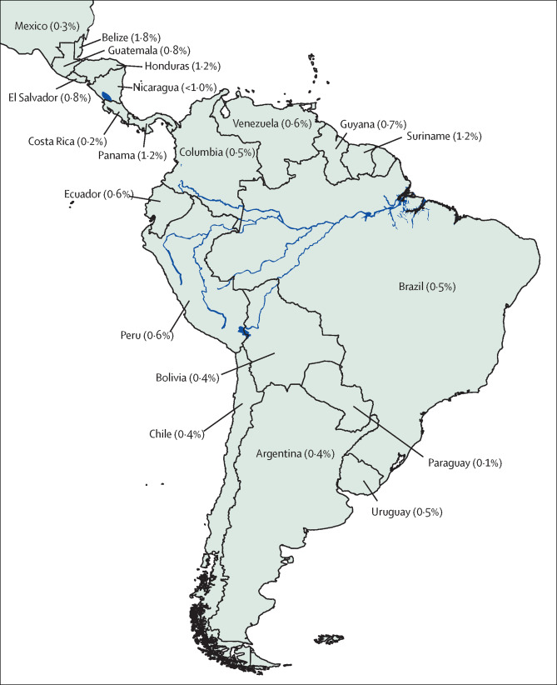
Figure. HIV prevalence in Latin American countriesSource: UNAIDS 2013.5
The HIV care continuum in Latin America: challenges and opportunities
null, Volume 15, Issue 7, 2015, 833–839
http://dx.doi.org/10.1016/S1473-3099(15)00108-5

Slide 9
HIV/AIDS IN LATIN AMERICA-LIMITATIONS
SURVEILLANCE:
Proportion of undiagnosed individuals and late HIV diagnosis
Most neglected test: HIV testing (2.4% spenditure in diagnosis)
Higher rate of transmission, Diagnosis at late stage of the disease
Argentina 30% population undiagnosed, Venezuela 60% population undiagnosed
Mexico cross-sectional study:
8000 MSM from 24 cities in Mexico
Prevalence 17% (2/3 of the population tested was unaware of their status)
PAHO. Art IN THE SPOTLIGHT: A PUBLIC HEALTH ANALSIS IN la AND THE Caribbean 2013.

Slide 10
HIV/AIDS IN LATIN AMERICA-LIMITATIONS
ACCESS TO HIV TEST AND ART TREATMENT
ART available in Latin-America for more than 10 years
Present late in to the disease
56% Argentina, 80% Chile and 79% Chile start ART with CD4 off 200cells per uL or less or with a history of an AIDS defining ellness.
Access to health Systems and stigma
No universal testing for pregnant woman/ no prenatal care at all
50% of pregnant women get HIV test in Colombia and Mexico (2011)
Pineirua et al. The HIV care continuum in Latin America: Thelancet July 2015

Slide 11
HIV/AIDS IN LATIN AMERICA-LIMITATIONS
HEALTH CARE EDUCATION:
Patients do not refuse… they just don’t get offer in many cases
“parteras”, pharmacist.
Perception of “who is at risk”
Stigma, discrimination, written consent
Pre-test counseling and no time for prevention

Slide 12
HIV/AIDS IN LATIN AMERICA-LIMITATIONS
LINKAGE AND RETENTION IN HIV CARE:
Linkage to medical care after diagnosis
Rural areas, busy people, lack of communication.
Study Crabtree-Ramirez and colleagues:
45% of late ART initiators were diagnosed with HIV at least 6months before treatment initiation (Colombia, Venezuela, Nicaragua)
Mean time of HIV diagnosis before initialtion was 2 years
Late ART initiation
Metsch et al. HIV transmission risk behaviors among HIV infected persons who are Succesfullly linked to care. CID 2008.
Fondo Colombiano de Enfermedados de Alto costo. SIDA en Colombia 2013.

Slide 13
HIV/AIDS IN LATIN AMERICA-LIMITATIONS
TREATMENT COVERAGE
Brazil: 81-93%
Chile, Mexico, Argentina 80%
Ecuador and Bolivia 40%
The higher the amount the cases: less money to treat
75% of HIV expenditures/Country
80% Provided by the National
WHO consolidated guidelines on the use of antiretroviral drugs for treating and preventing HIV infection.
Recommendations for a public health approach. WHO 2013

Slide 14
HIV/AIDS IN LATIN AMERICA-LIMITATIONS
HIV VIRAL LOAD SUPPRESION
Venezuela 12%,Mexico 25% achieve viral suppresion
Colombia 50% of HIV patients were retained in care and 14% achieve viral suppression.
30% in US
Pineirua et al. The HIV care continuum in Latin America: Thelancet July 2015

Slide 15
HIV/AIDS IN LATIN AMERICA THE HAITIAN EXPERIENCE
Life expectancy is 52 years
65% of Haitians live in extreme poverty (before earthquake)
1 physician per 10 000 habitants
8US dollars: annual per capita health expenditure
Public Health Aspects of HIV/AIDS in Low and Middle Income Countries ...
By David Celentano, Chris Beyrer. Springer, 2010.

Slide 16
HIV/AIDS IN LATIN AMERICA THE HAITIAN EXPERIENCE
The Stigma
4H
“Homosexual, Hemophiliacs, Heroin addicts and Haitians”
FDA: Haitians prohibited to donate blood
CDC: Placed as a risk factor for HIV
Effects on tourism in Haiti: Immediate and devastating

Slide 17
HIV IN LATIN AMERICA THE HAITIAN EXPERIENCE
Same risk factors: higher mortality
65% of cases in the Caribbean
1980’s:
Poorest nation in the West hemisphere
Political situation
No economical resources
Discrimination
2010 Earthquake
Public Health Aspects of HIV/AIDS in Low and Middle Income Countries ...
By David Celentano, Chris Beyrer. Springer, 2010.

Slide 18
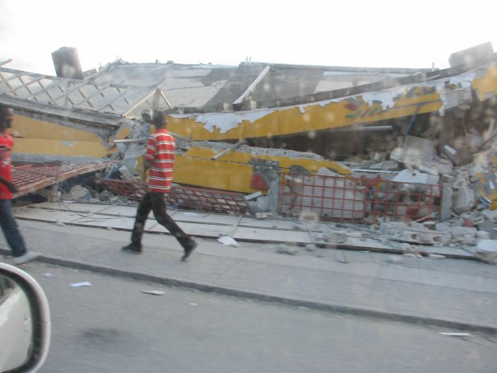
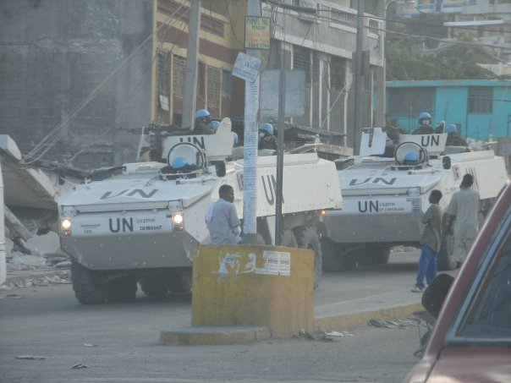
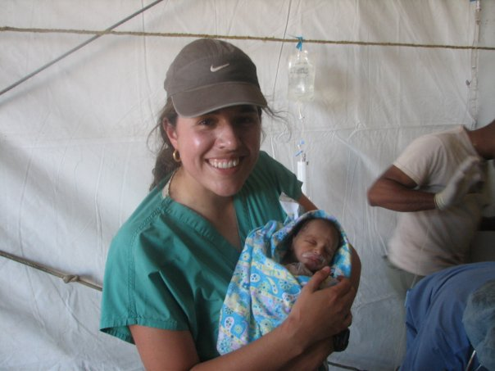
Earth quake limitations

Slide 19
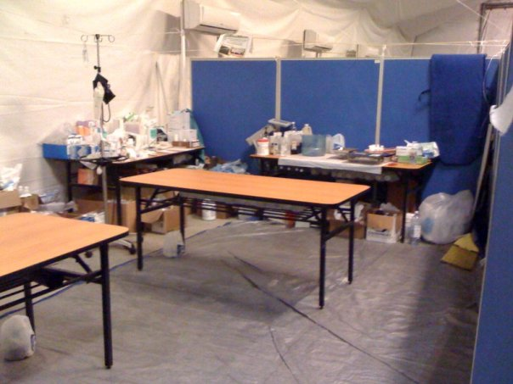

Slide 20
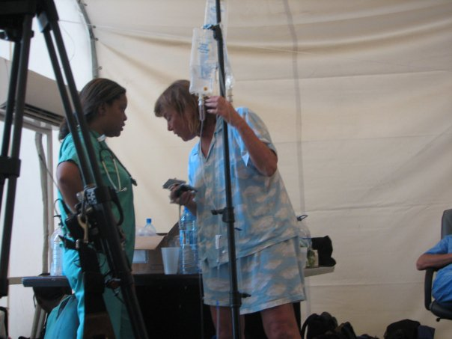

Slide 23
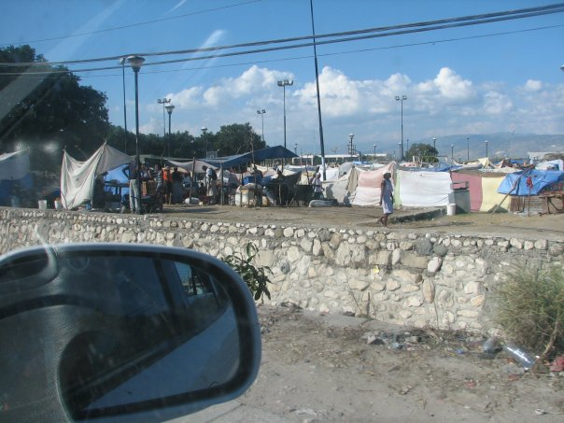

Slide 24
Pic of punta cana

Slide 25
HIV/AIDS IN LATIN AMERICA THE CARIBBEAN EXPERIENCE
Second most affected population in the Americas
Dramatic decline in mortality in US, Canada and Brazil
Caribbean struggle to provide ART to high priorities (AIDS)
1.6% of the population lives with HIV
1.2% Barbados, Jamaica and Dominican Republic
2.4% Haiti, Bahamas
0.1% Cuba
Leading cause of death among 24-44 year old adults in Dominican Republic and Haiti
Predominates clade B (same than US)
Public Health Aspects of HIV/AIDS in Low and Middle Income Countries ...
By David Celentano, Chris Beyrer. Springer, 2010.

Slide 26
HIV IN LATIN AMERICA THE CARIBBEAN EXPERIENCE
Dominican Republic:
Estimated cases 66 000 in 2010.
Reported: 17 000
Only 30% of reported have access to ART
Problems:
Tourism:Prostitution
Stigma: bisexual behavior, condom use.
Education

Slide 27
HIV/AIDS IN LATIN AMERICA MEXICO: POOR NORTH AMERICANS
Highest prevalence in Northern areas
First cases from patients traveling from US
Early intervention in checking blood supplies
Homosexual and Bisexual most prevalent population
Women with highest incidence
Universal access to ART
Shortages
Difficult access to testing labs
Lack of appropriate level of education in healthcare professionals

Slide 28
HIV IN LATIN AMERICA PERU: NEGLECTED BY THE GOVERNMENT
First case in 1983 from immigrant from US.
60% population infected is Heterosexual
Government denial, disorganization,unpredictable
Prostitutes and prisioners
NGO’s and private organizations
Expansion of ART is the focus in the latest years.
2004: ART widely available

Slide 29
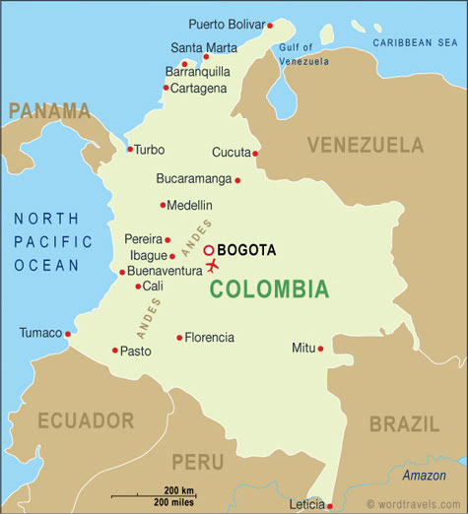
HIV-AIDS IN LATIN AMERICA COLOMBIA

Slide 30
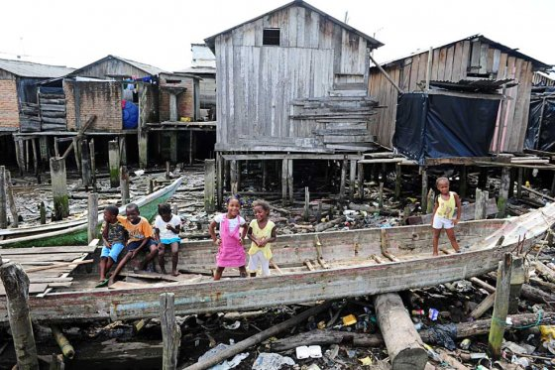
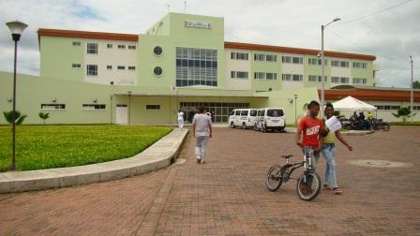

Slide 31
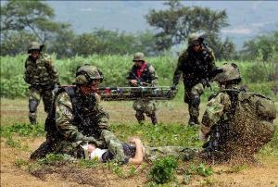

Slide 32
MISS TUMACO

Slide 33
HIV-AIDS IN LATIN AMERICA COLOMBIA
Communication
Travel to HealthCare centers
Phone calls
Address??

Slide 34
HIV-AIDS IN LATIN AMERICA COLOMBIA
Patient with opportunistic infections
Diagnosed at AIDS stage
Delay in diagnosis
Delay in treatment
Constant change in treatment
Delay in Linkage to HIV centers
HealthCare workers on strikes

Slide 35
HIV-AIDS IN LATIN AMERICA COLOMBIA
Access to drugs
Access to testing
Transportation to outpatients
Patients cant write or read

Slide 36
HOPE

Slide 37
HOPE
1982 GHESKIO in Haiti:
Haitian study group on Kaposi Sarcoma and Opportunistic infections (Cornell)
Descentralization of HIV testing in Nicaragua
Increased 6 times diagnosis of HIV
Argentina: Offers free testing
Colombia: All HealthCare workers obligated to take HIV counseling and testing class
The role of NGO’s
The role of research in Latin American Countries

Slide 38
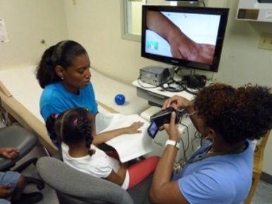
HOPE

Slide 39
HOPE

Slide 40
CURE

Slide 41
CONCLUSIONS
Latin American countries face many challenges regarding HIV diagnosis and engagement in HIV care.
The absence of reliable data makes it difficult to develop and implement tailored interventions that could improve HIV care outcomes.
Establishment of appropriate national databases would provide information about epidemic dynamics in local and national settings.
The fight against stigma and discrimination is an important factor in the HIV care continuum.
Education of patients and health-care providers is an essential intervention to reduce stigma and missed opportunities of early HIV diagnosis.

Slide 42
CONCLUSIONS
A combination of strategies that includes the integration of multidisciplinary approaches to reduce transmission will be most effective.

